Slide 1
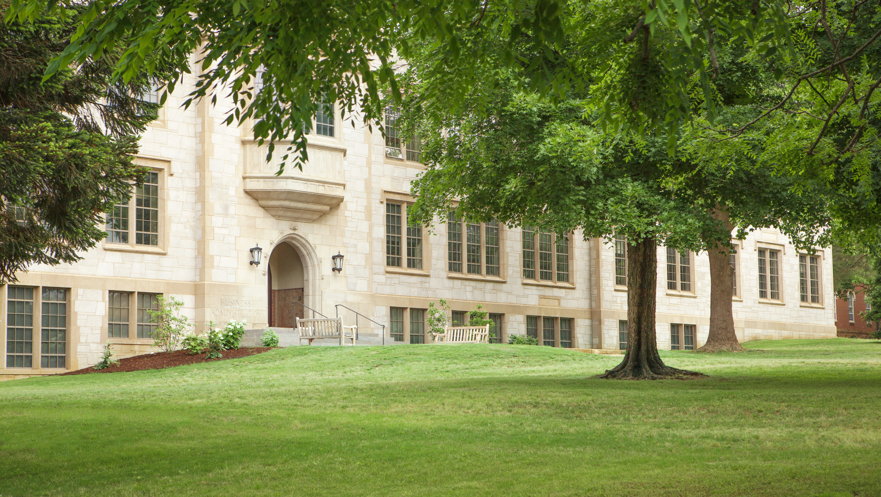
Annual Report: July 1, 2020 to June 30, 2021
gsie.uark.edu

Slide 2
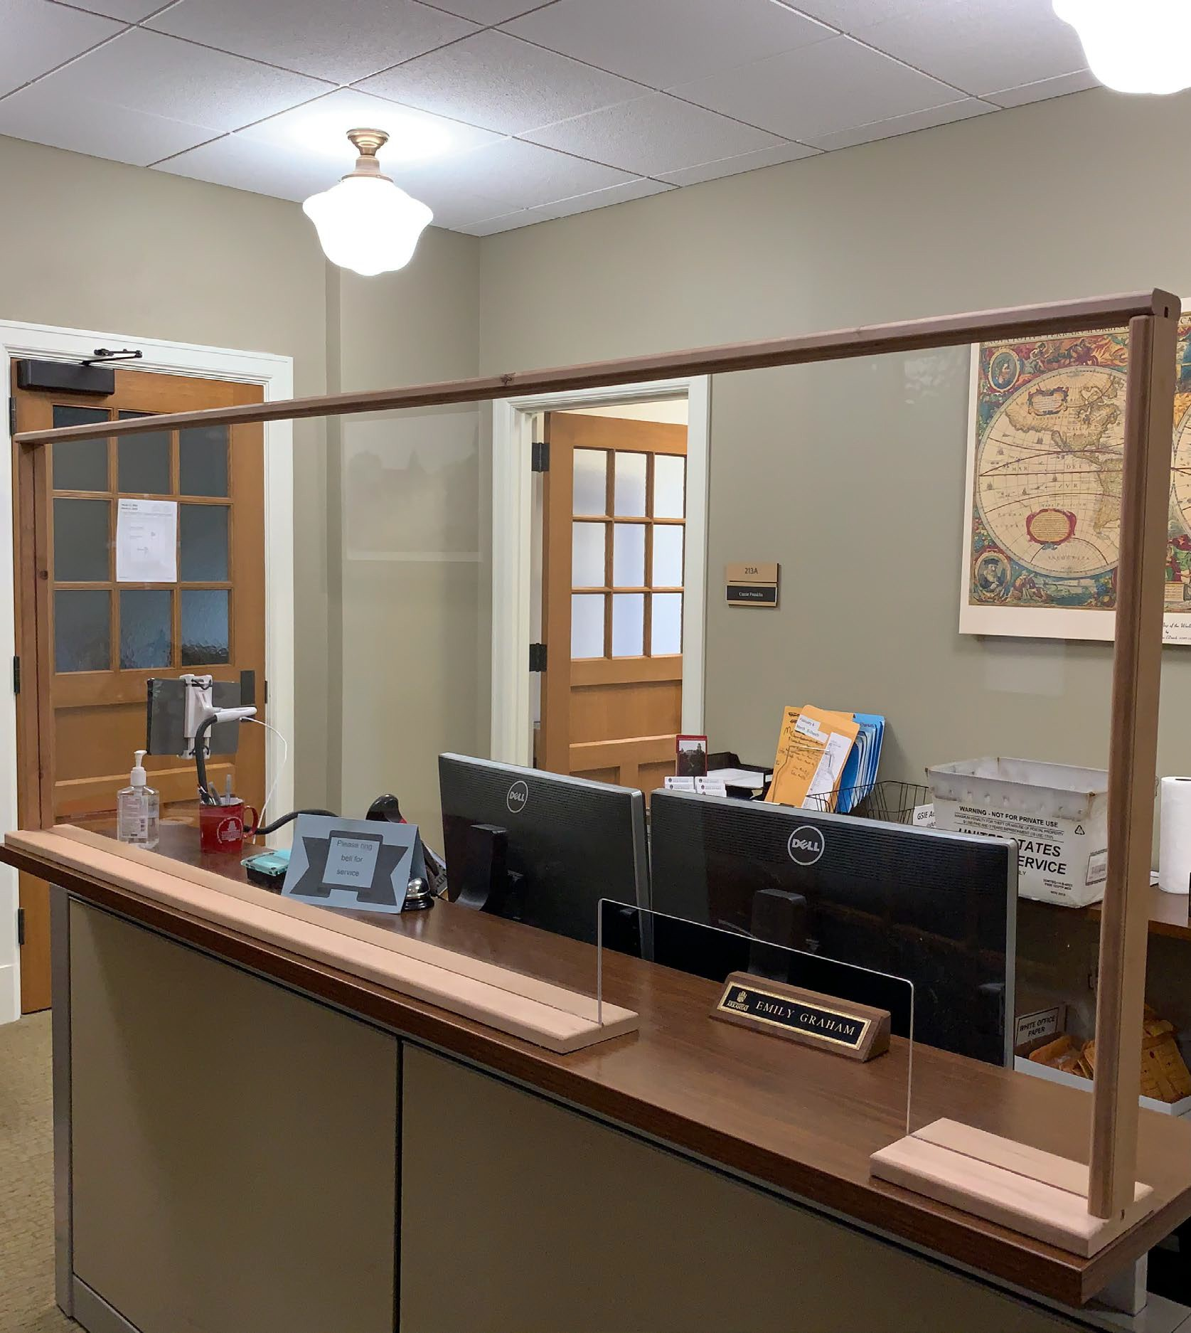
Executive Summary
The 2020-2021 was a year of change in higher education across the nation and especially in the Graduate School and International Education. In Fall 2020, our time was dominated by our continued response to the COVID-19 pandemic and the reopening of our campus. By August, the majority of our unit returned to face-to-face operations with masks and social distancing. With international travel suspended, our study abroad staff began offering virtual internships and study abroad experiences to students on our campus and Rome Center faculty began teaching UAF courses and collaborating with UAF faculty on a variety of projects. Testing Services reopened its in-person center with social distancing restrictions and continued to offer many tests online.

Slide 3
Executive Summary
The All-University Commencement ceremonies held in December and May returned to in-person/socially distanced events and our graduation processing team continued to support students and faculty by handling all documents both in digital and paper formats throughout the year. International Students and Scholars worked tirelessly to support incoming international students who faced uphill battles securing visas and navigating international travel restrictions. Our student and program support offices continued to offer their services through a digital format and our student orientations in August and January were fully virtual.

Slide 4
2020 also saw leadership change in the Graduate School and International Education as Provost Charles Robinson appointed Dean Kim Needy to become Dean of the College of Engineering in November. He likewise appointed Associate Dean Patricia Koski to become the Dean of the Graduate School and International Education.
James Gigantino, the chair of the department of history, joined the unit in January 2021 as the Associate Dean of the Graduate School.
Executive Summary

Slide 5
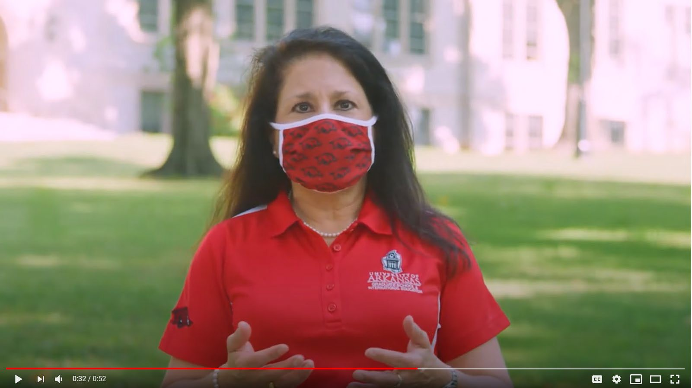
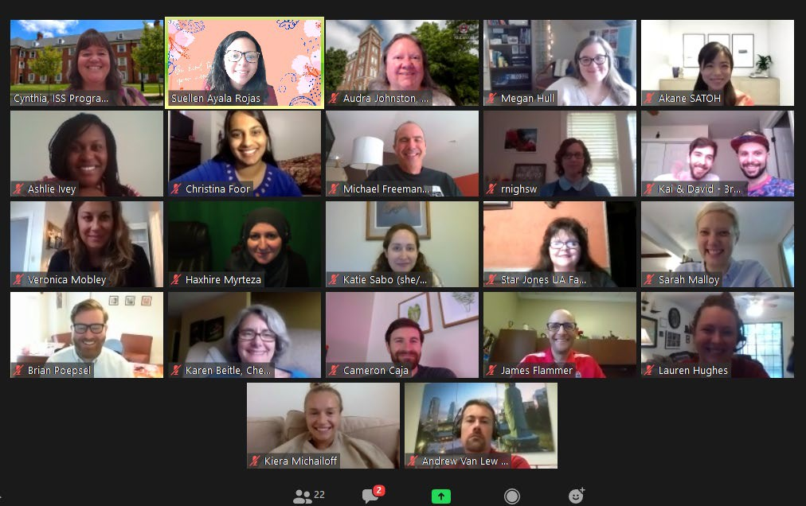
Oh what a year it was..

Slide 6
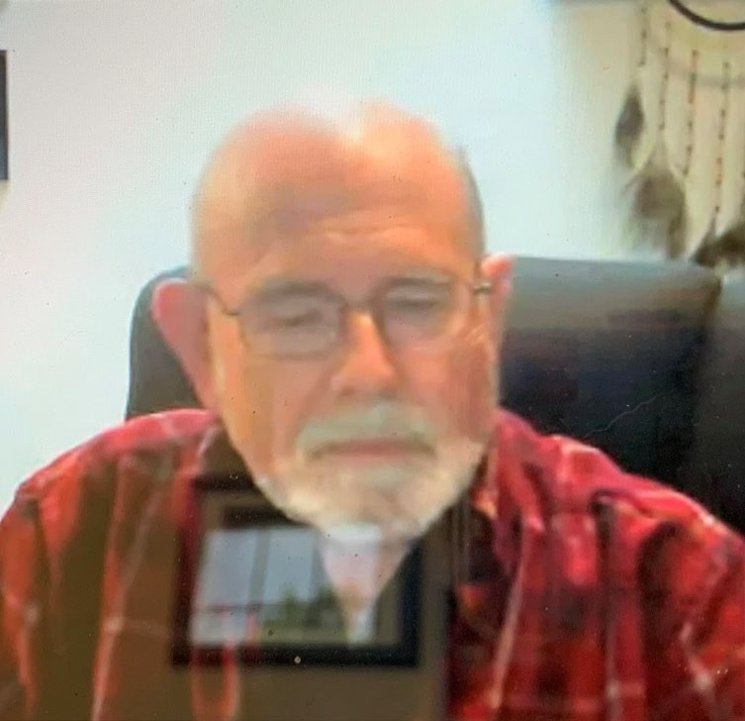
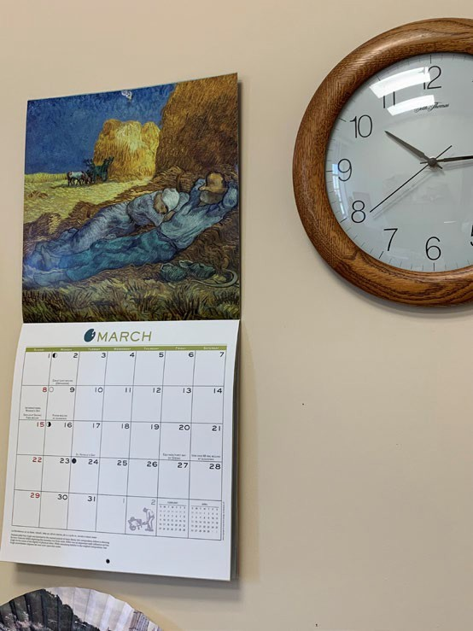
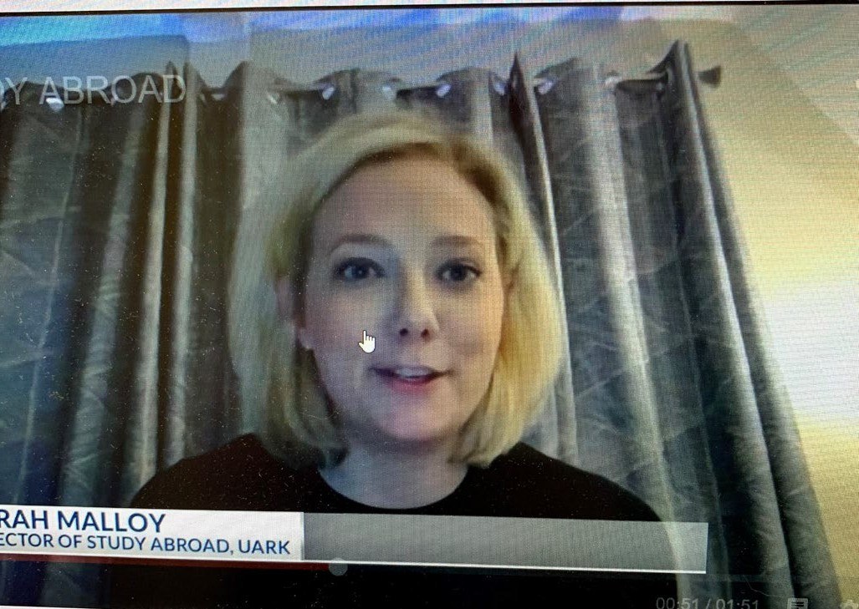
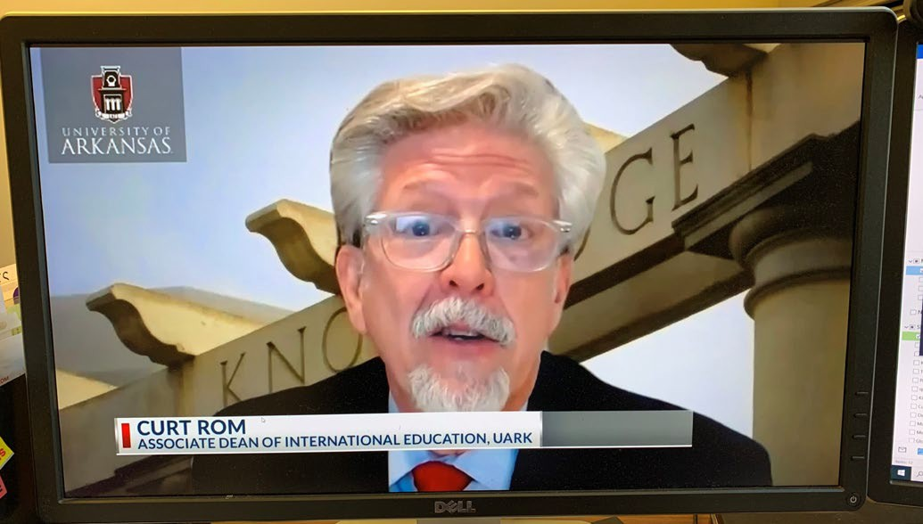
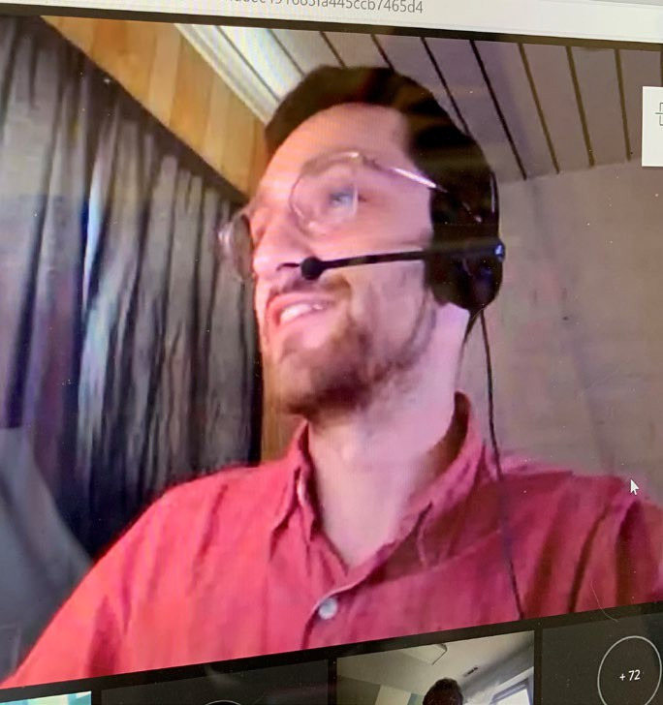
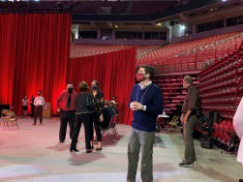
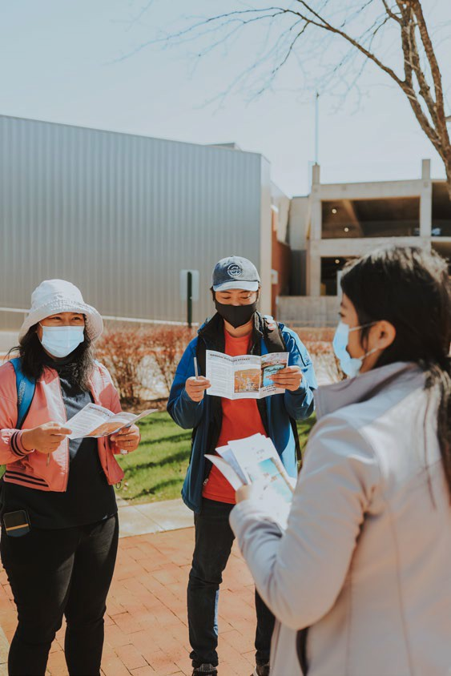
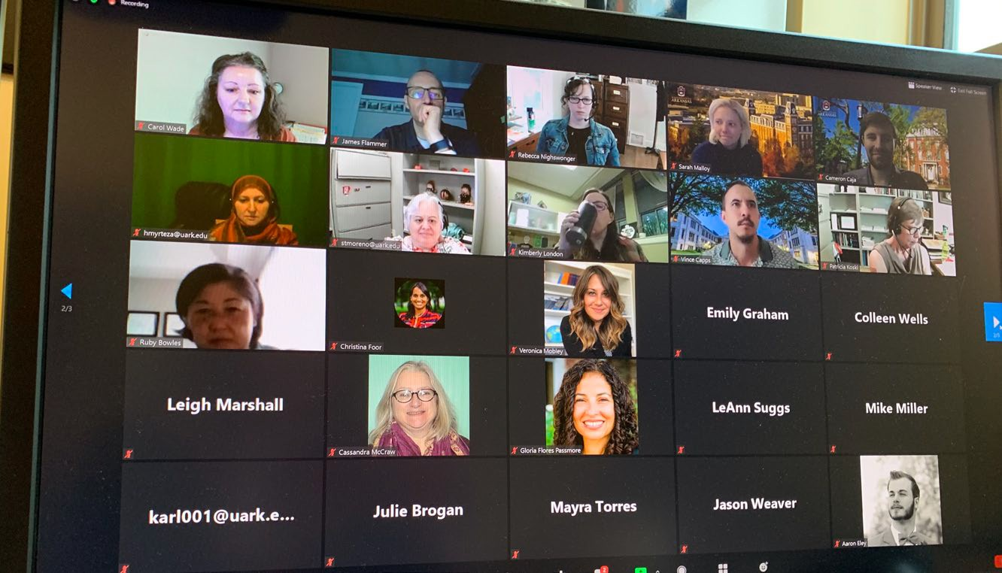
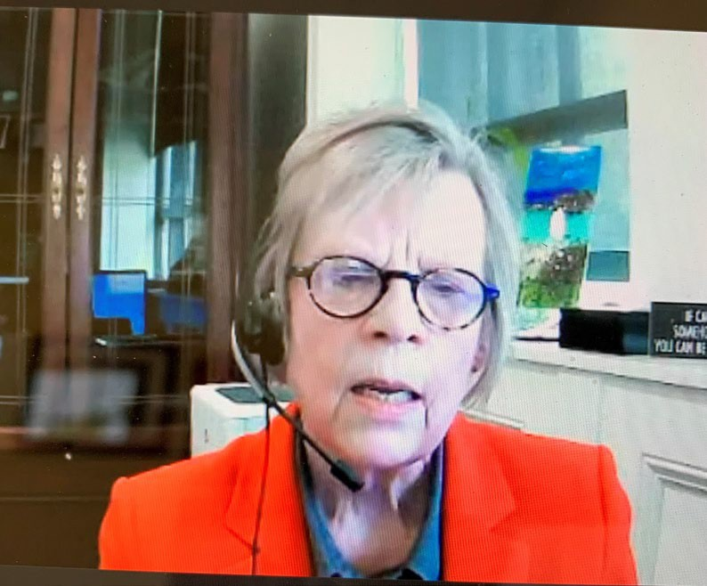
Virtual, masked and separated…

Slide 7
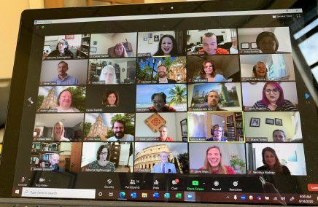
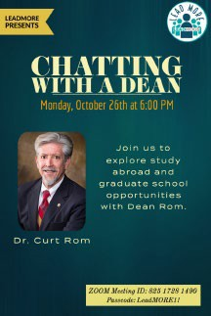
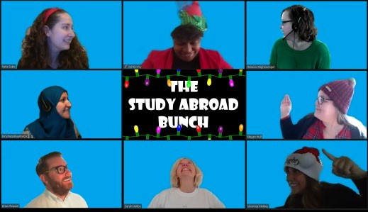
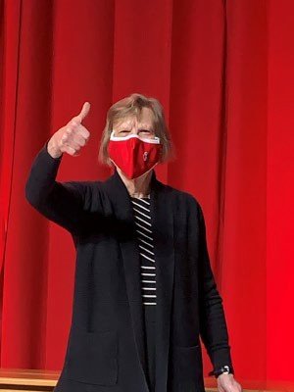
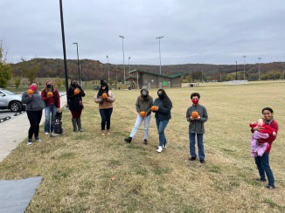
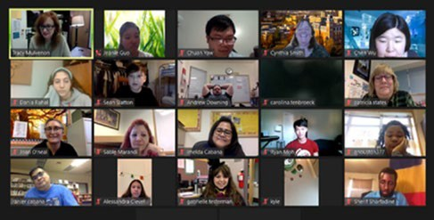
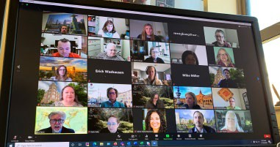
..but most of all creative and committed…

Slide 8
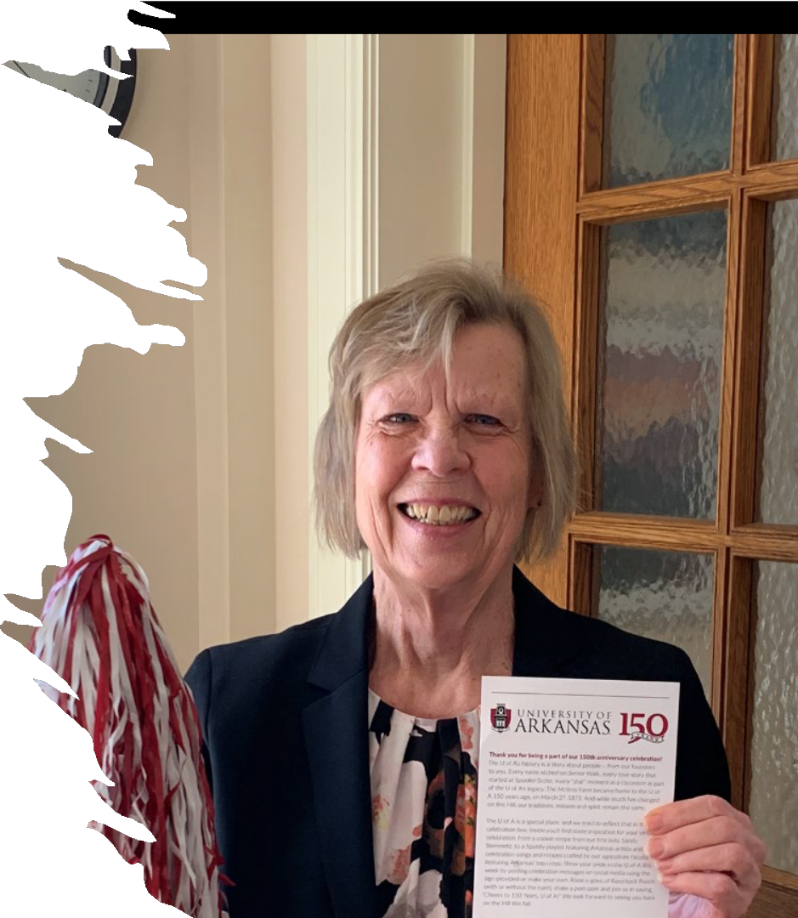
And the University turned 150!

Slide 9
Between July 1, 2020 and
June 30, 2021,
we said hello to…

Slide 10
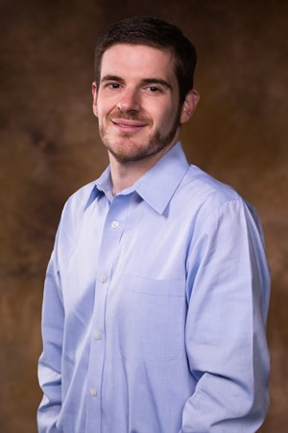
Jim Gigantino
Associate Dean for the Graduate School

Slide 11
Nami Bagirimvano
International Students and Scholars

Slide 12
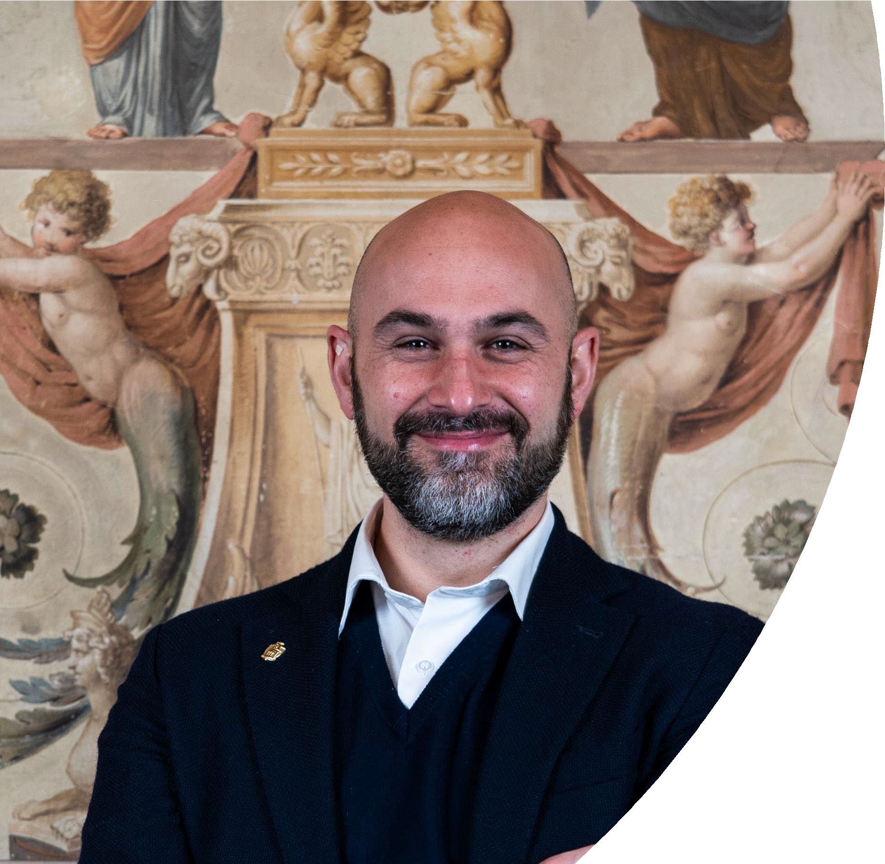
Matteo Cittandini Rome Center

Slide 13
Sara Giacani Rome Center

Slide 14
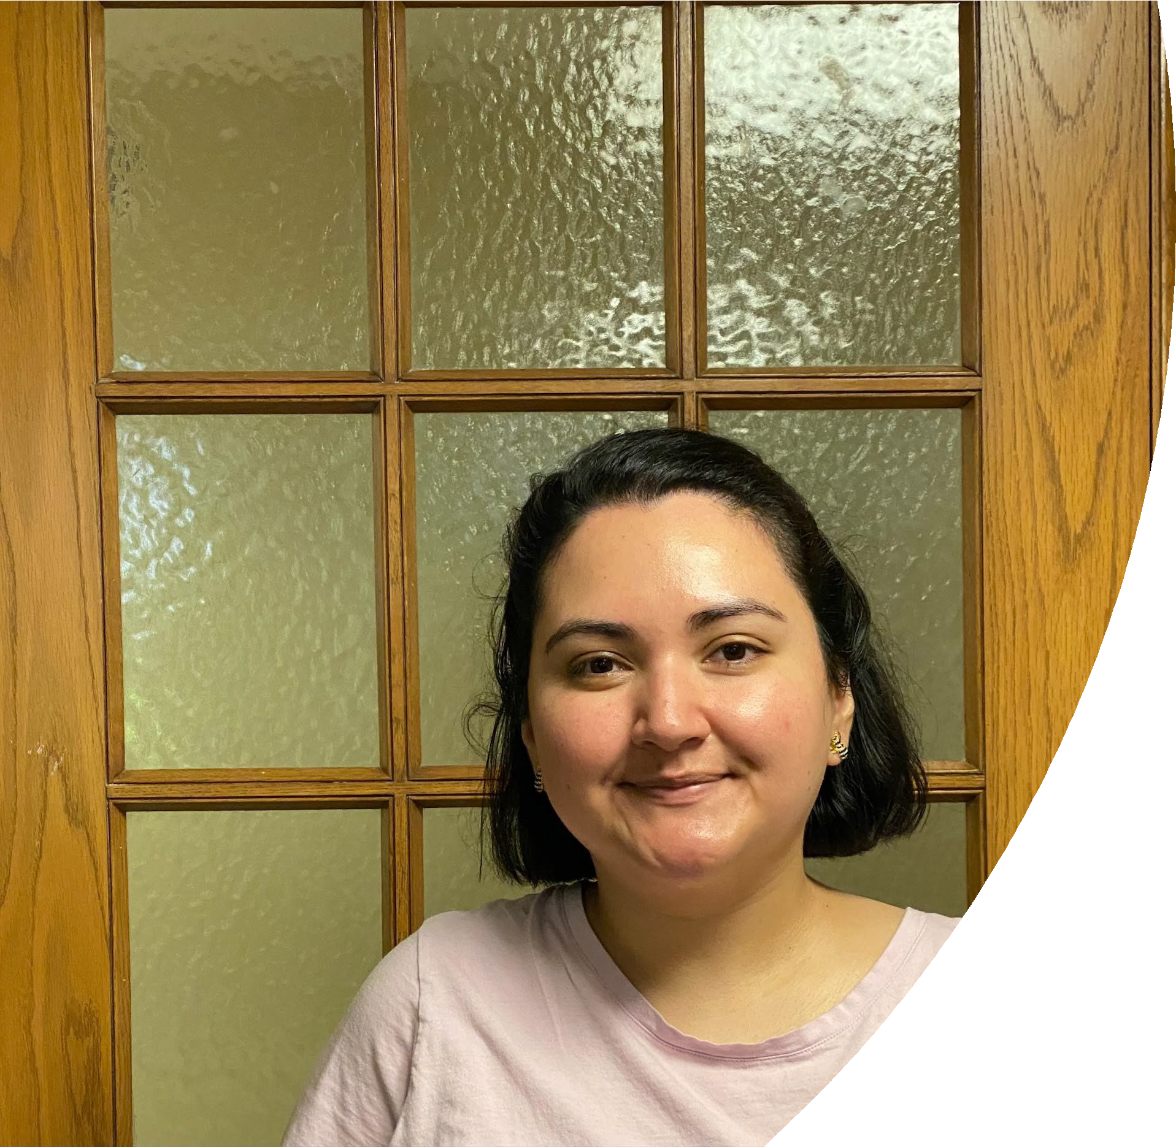
Daisy Juarez Graduate Recruitment and Admissions

Slide 15
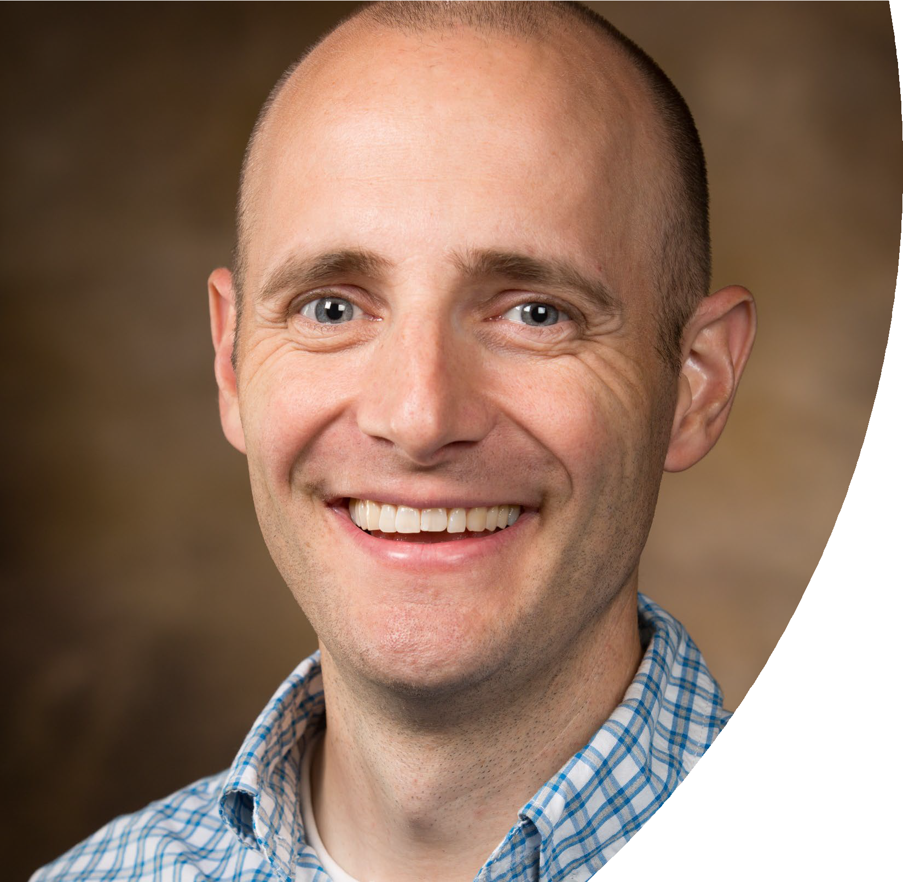
James Flammer International Students and Scholars

Slide 16
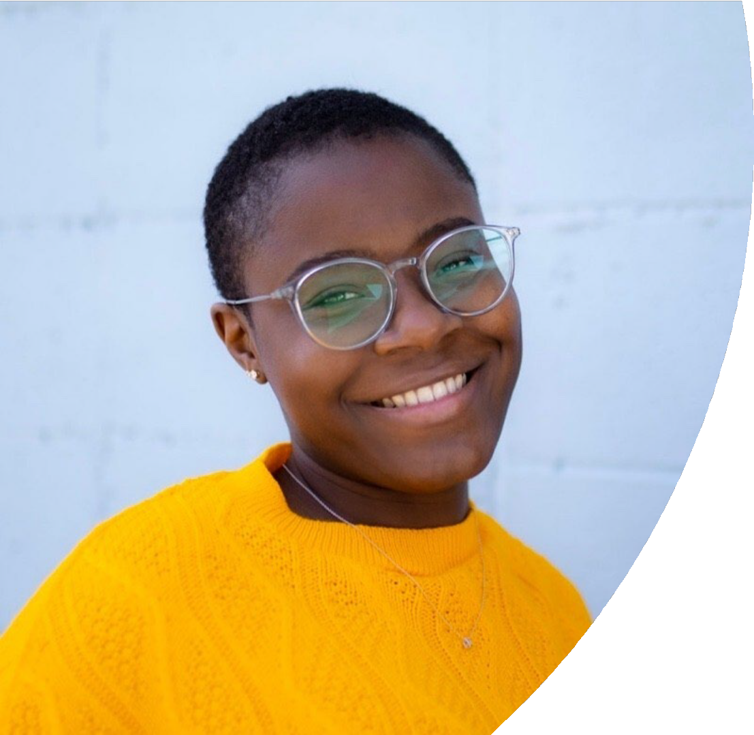
MyKayla Bowser Study Abroad and International Exchange

Slide 17
Dakota Kalkstein
Registration; graduation; development

Slide 18
We said goodbye to…
Shanedra Barnes
Catherine Cunningham
Emilio Del Gesso
Viviana Sabbatini
Carol Wade
Heather London
Meng Kong
Hannah Franklin
Mohammed Ibrahim
Vinci Chan
Emilijia Sarma
Alex Gackle
Aaron Ely
Heather Johnson

Slide 19
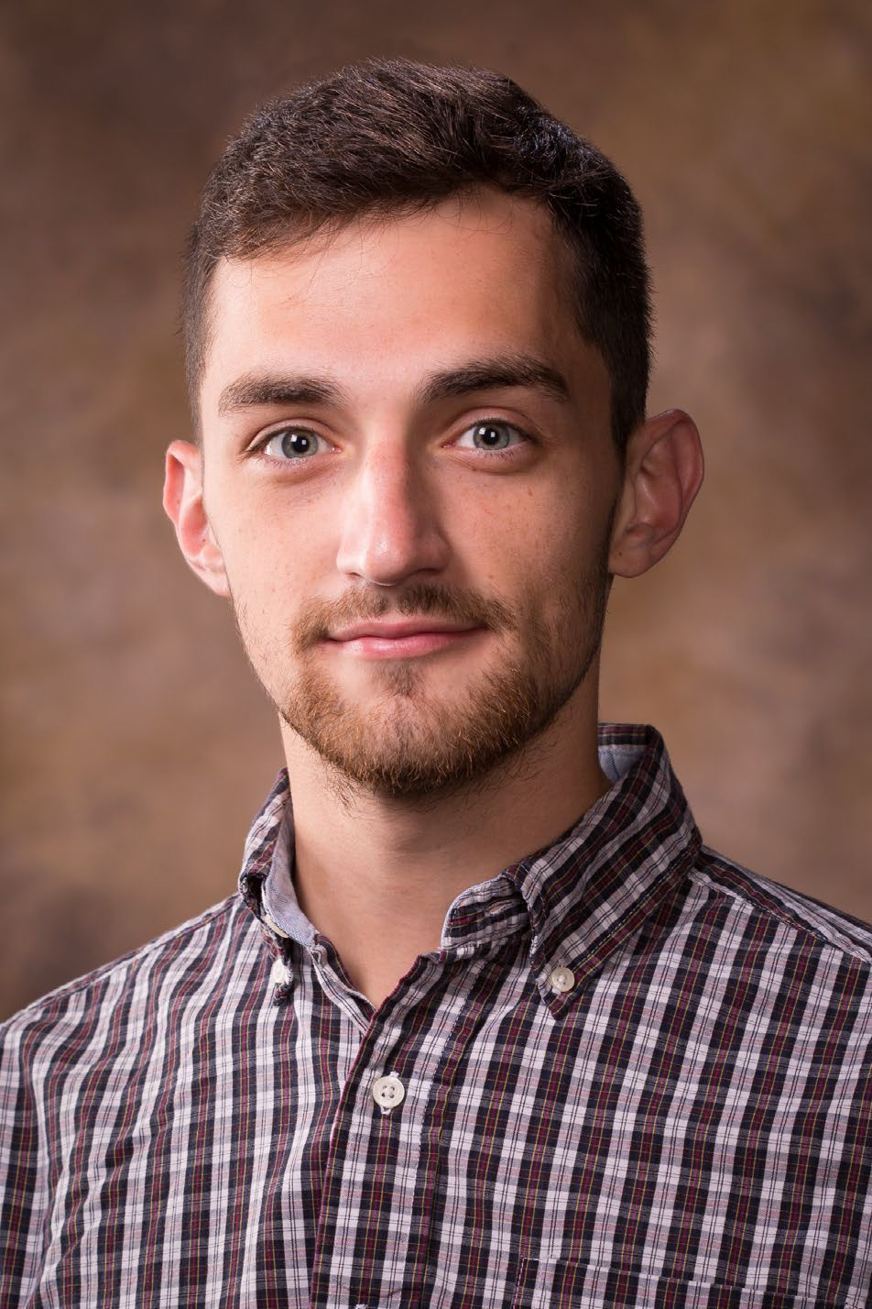
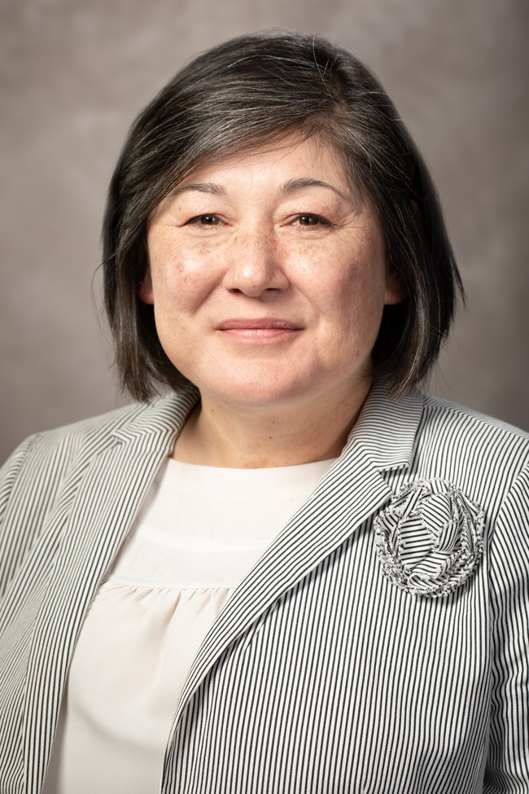
We said goodbye and hello to…
Ruby Bowles, moved from Recruitment and Admissions to International Students and Scholars
John Mark Cagle, moved from Recruitment and Admissions to GSIE Communications

Slide 20
We changed organizational units…
From Graduate Fellowships and Program Support to Graduate Student Fellowships, Registration and Graduation
Vicky Hartwell, Director
Kerry Cole, Leigh Marshall, Therese Moreno, Julie Rogers
From Sponsored Students to Sponsored Students and Special Programs
Gloria Flores Passmore, Director
Cameron Caja, Jacob Hiatt, Lauren Hughes, Michael Rau, Mayra Torres

Slide 21
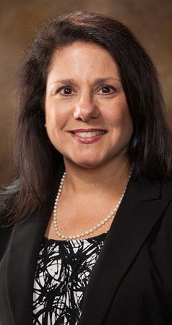
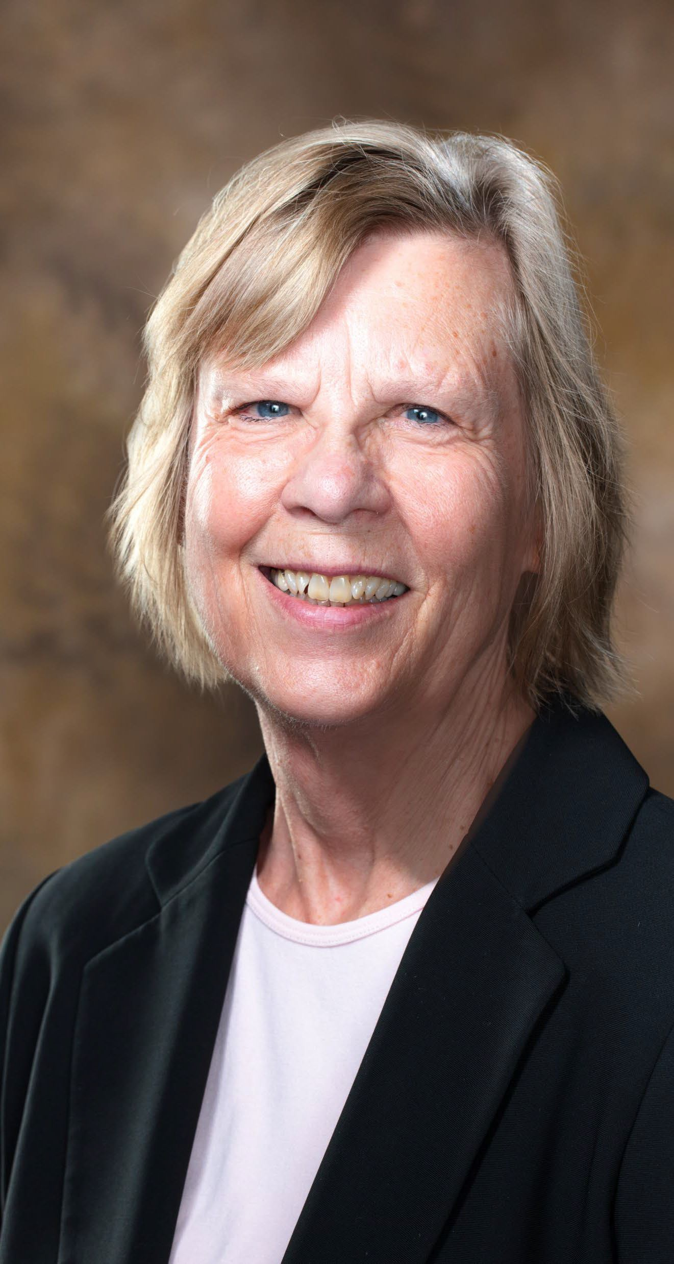
And we changed deans…

Slide 22
Dr. Needy’s Top 10 List of What She Will Miss About GSIE
In David Lettermen style, let me share with you the Top 10 Things I’m Going to Miss About GSIE
6. Travel to wonderful international destinations where I have had the pleasure of working with alumni, friends and colleagues in their home countries including Panama, Japan, France, Bolivia and of course Rome, Italy!
10. Queso! Queso you ask? You see queso is a metaphor for optimism, stability, security, and confidence that the future will be brighter. When I first joined GSIE on an interim basis in April 2014, I recall Gloria asking Sedivy where’s the queso as we prepared our lunches for the May commencement rehearsal. Sedivy replied that there was none as we couldn’t afford to buy it. I had two immediate thoughts. First, what have I done…leaving one of the richest units on campus and moving to one of the poorest? And the second thought that came to me, somewhat in the form of a battle cry, is that we will have queso at the next commencement luncheon!
9. The One Book One Community Program that we have participated in together
8. The acknowledgement that we are a service unit and with this comes great responsibility. I came across a recent quote about service, written by Leo Tolstoy, a Russian writer who is regarded as one of the greatest authors of all time. He said “It is within my power to serve the Universe or not. Serving the Universe, I add to my own good and the good of the whole world. Not serving the Universe, I forfeit my own good and deprive the world of that good, which was in my power to create.” Let me re-read this again and substitute the word “Universe” with “University.” “It is within my power to serve the University or not. Serving the University, I add to my own good and the good of the whole world. Not serving the University, I forfeit my own good and deprive the world of that good, which was in my power to create.”
7. International Education Week – and the dozens, upon dozens of events, one of which is International Dress Day, my personal favorite.
5. The realization that we can assemble in less than 3 minutes, if an email goes out announcing that there is food to share…bagels, donuts, cookies, or just about anything. Leftovers just never go to waste in this unit.
4. The monthly GSIE newsletter prepared by Cassie with contributions from each of you. My favorite part is just looking at all the beautiful pictures celebrating our unit and each one of you. The monthly newsletter is is followed closely by the reading of “Examples of GSIE Staff Meeting Unit Goals” at our monthly staff meeting.
3. GSIE traditions including the Haunted House created and shared with us by the Admissions Staff, Thanksgiving Potluck, GSIE Holiday Potluck with the added fun of the ugly sweater & tie competition and the BINGO grab bag.
2. Writing to you daily during the coronavirus pandemic beginning on March 19 and ending on August 21. But what I’ll miss more than writing these daily messages, is receiving daily responses from you allowing us to connect on a personal level.
•
1. You! Yes, each and every one of you and your awesome talents, your passion for what you do, the love you share, your selflessness, and how you have made me stronger and filled my life with immense joy. I will miss my GSIE family terribly, but don’t forget, I’m just moving next door so I expect to see you all often.
•
•
•

Slide 23
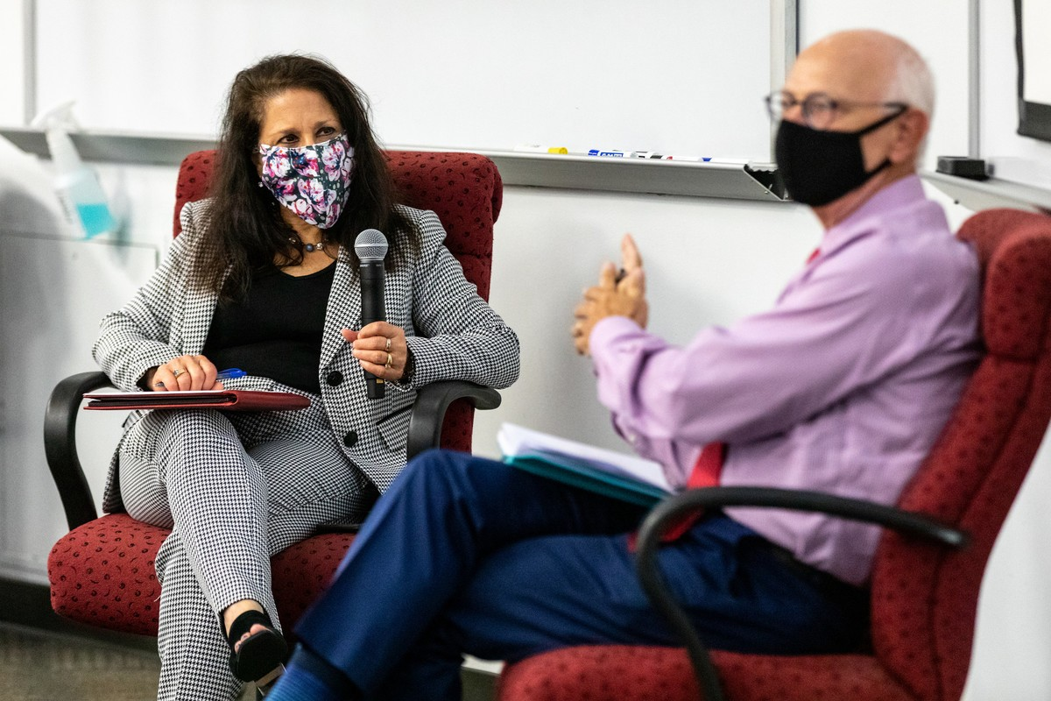
GSIE Top 10 List of Why We Will Miss Dean Needy!
10. We will miss her emails arriving at 4:15 a.m.
•
9. We will miss learning the history and culture of Pittsburgh.
•
8. We will miss her sense of style – can you say Bright Colors?!
•
7. We will miss her willingness to mentor and help others grow.
•
6. We will miss her daily email updates – wait, we already miss those!
•
5. We will miss the way she laughs at an increasing rate when she is
exhausted.
•
4. We will miss her gifts – including the bagels, pizza, cookies and donuts.
•
3. We will miss her ability to be nice and strong in the same breath.
•
2. We will miss her superpower as the first female dean in GSIE.
•
1. We will miss working with the best dean we could ever have.
•

Slide 24
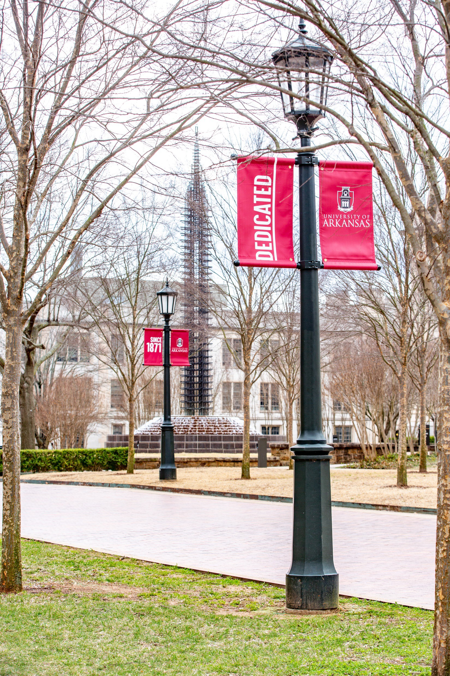
VISION
The Graduate School and International Education assists the University of Arkansas in excelling at research, teaching, training, and service while fostering student and scholar success and enhancing the overall student academic experience.

Slide 25
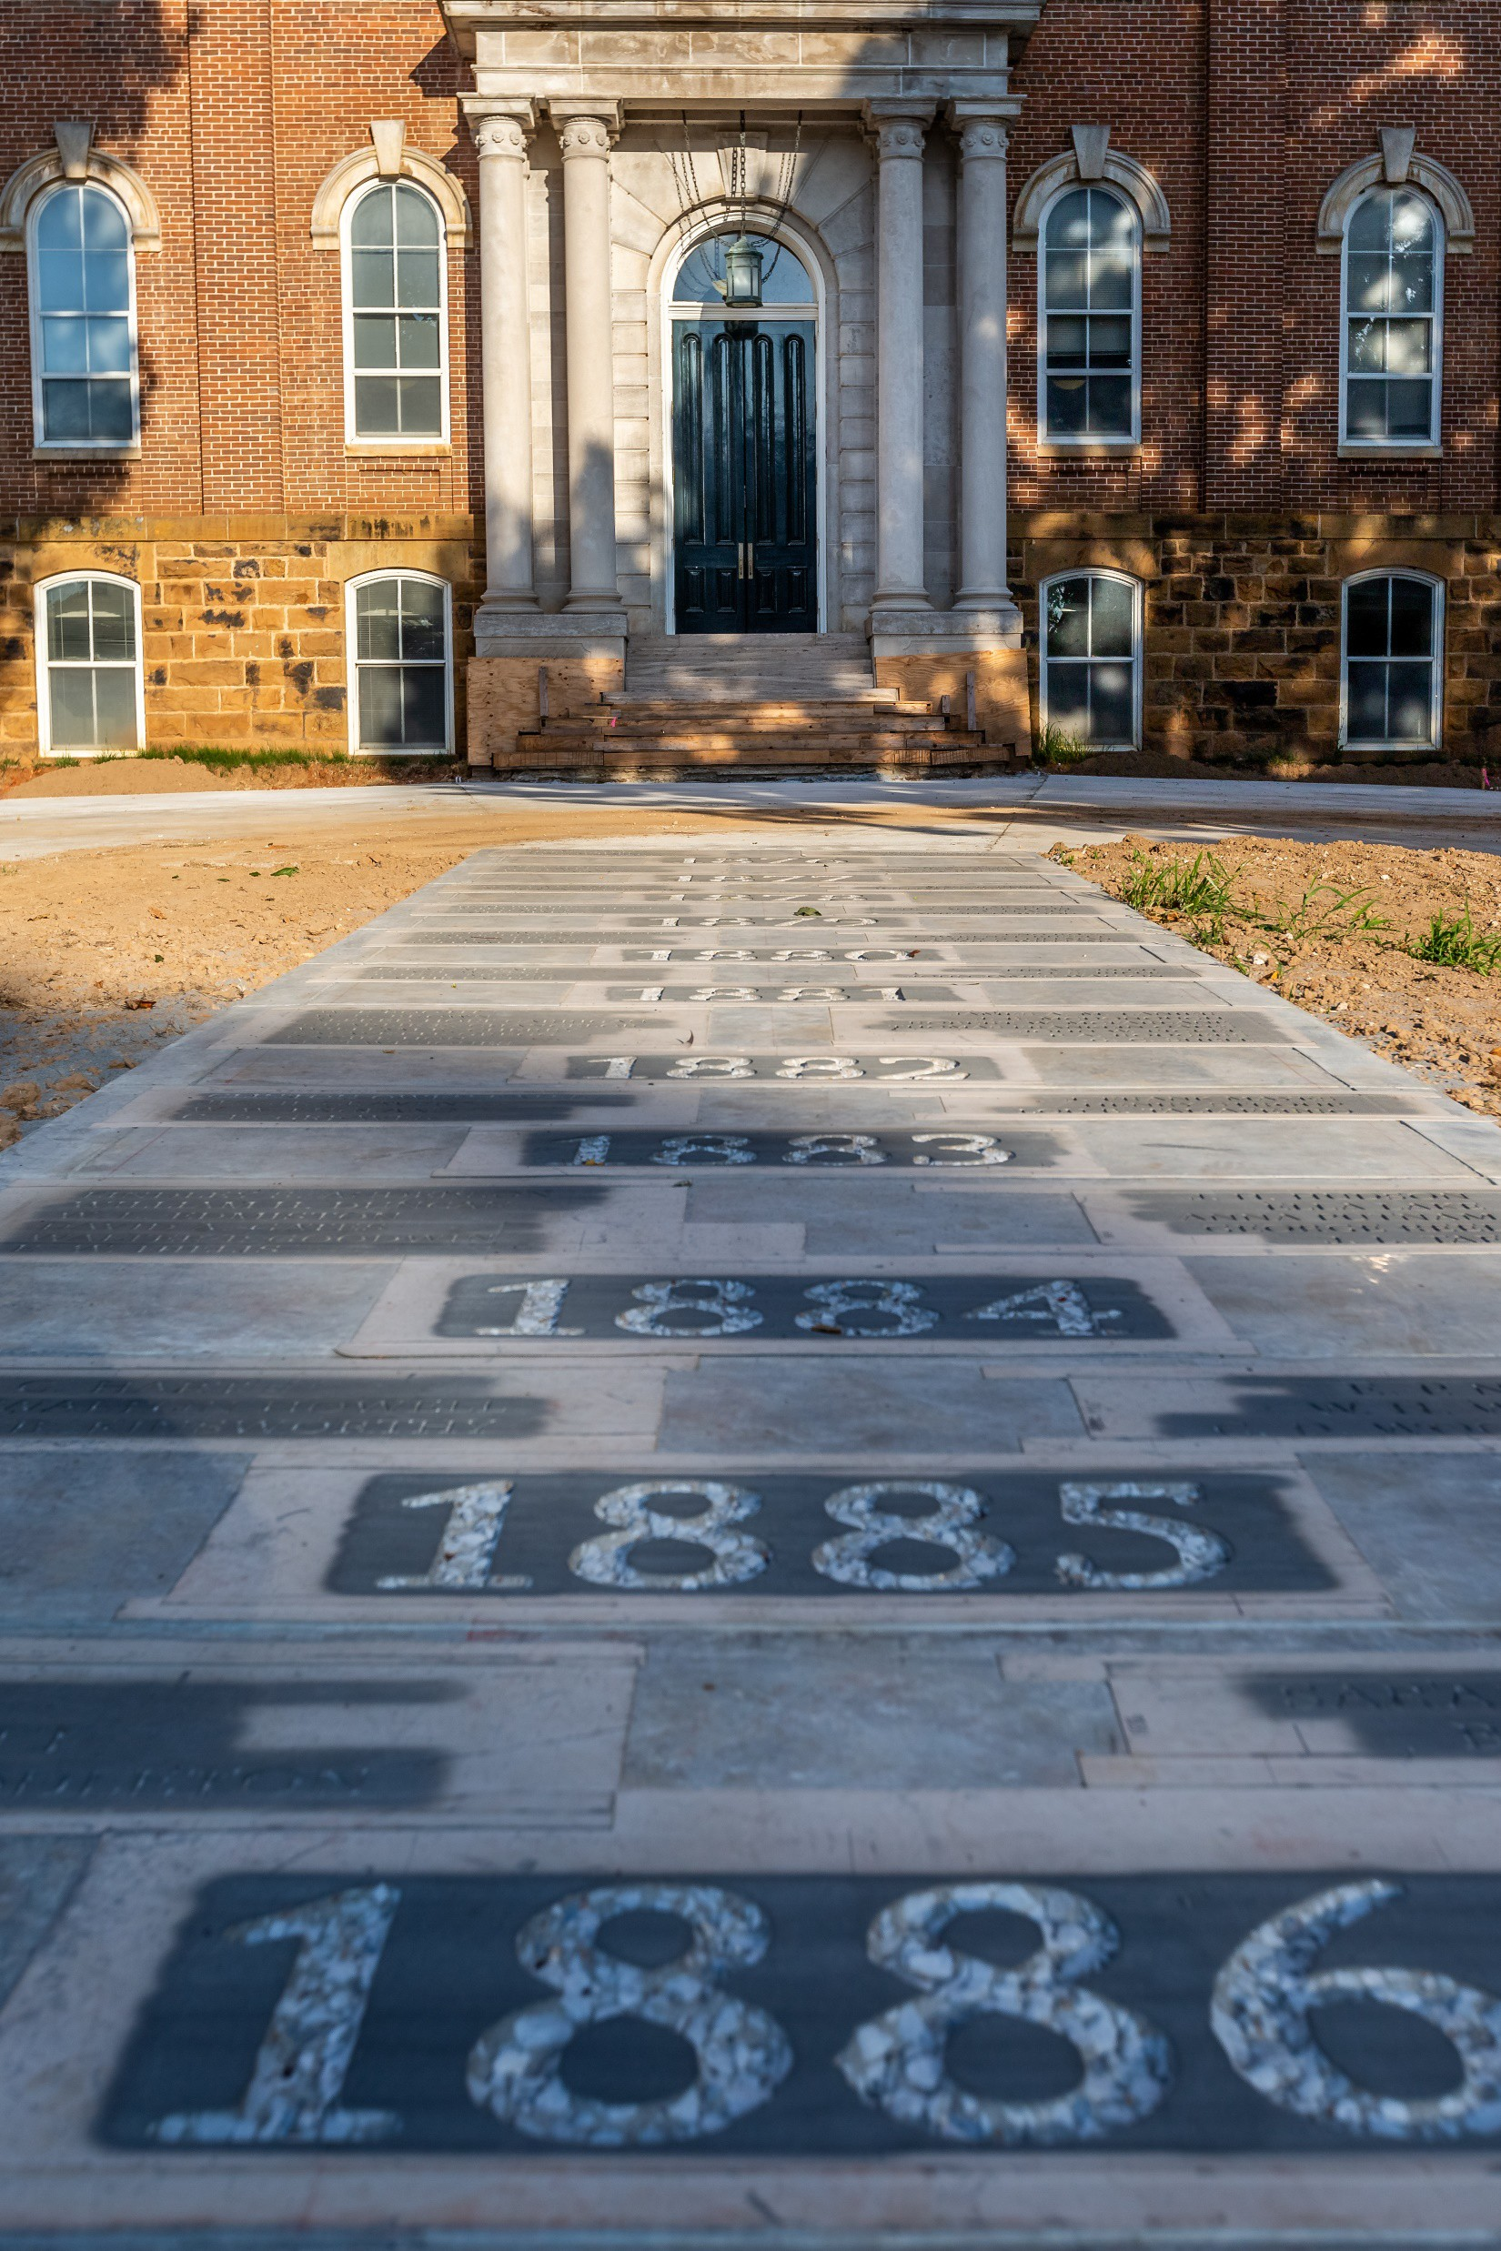
MISSION
The Graduate School and International Education supports the strategic goals of the University of Arkansas to continue as a very high research university; recruits, retains and graduates high-caliber students; advocates for students and student success; facilitates intercultural and international experiences to increase global competencies; and assists in the development of international, inter- disciplinary, and graduate programs.

Slide 26
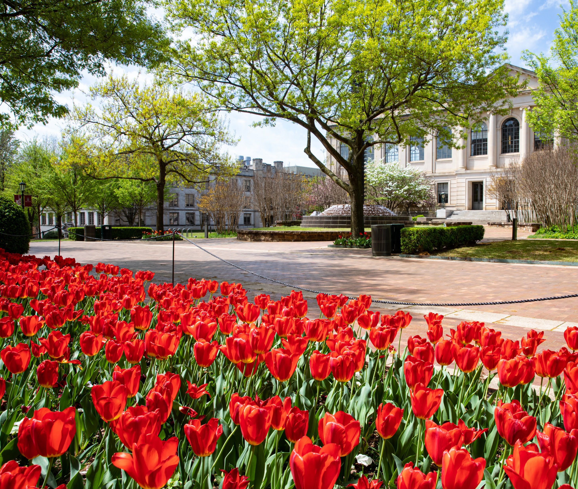
Annual Report
Notable Achievements and Changes – unit wide
GSIE
Graduate School
International Education
Interdisciplinary Studies

Slide 27
Notable Achieve- ments and Changes – Unit Wide
University Awards
Professional Awards
Other Awards
Development

Slide 28
Karl Anderson – Employee of the Quarter
and Employee of the Year
University Awards – Staff Senate

Slide 29
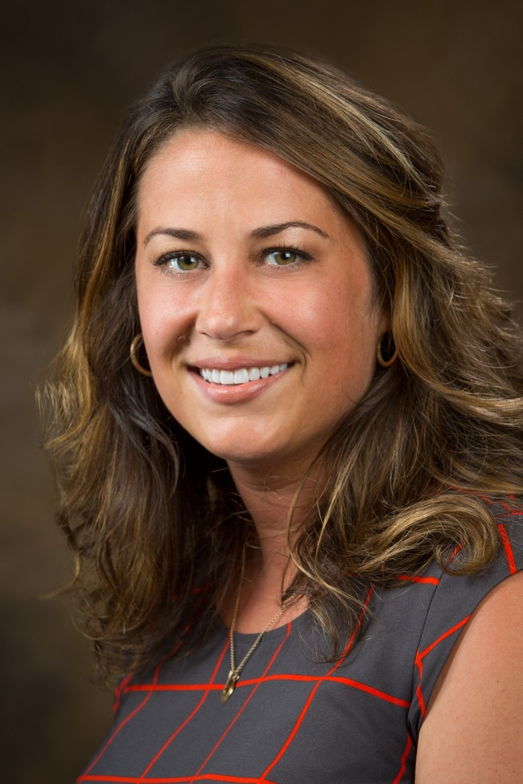
Veronica Mobley – Employee of the Quarter
University Awards – Staff Senate

Slide 30
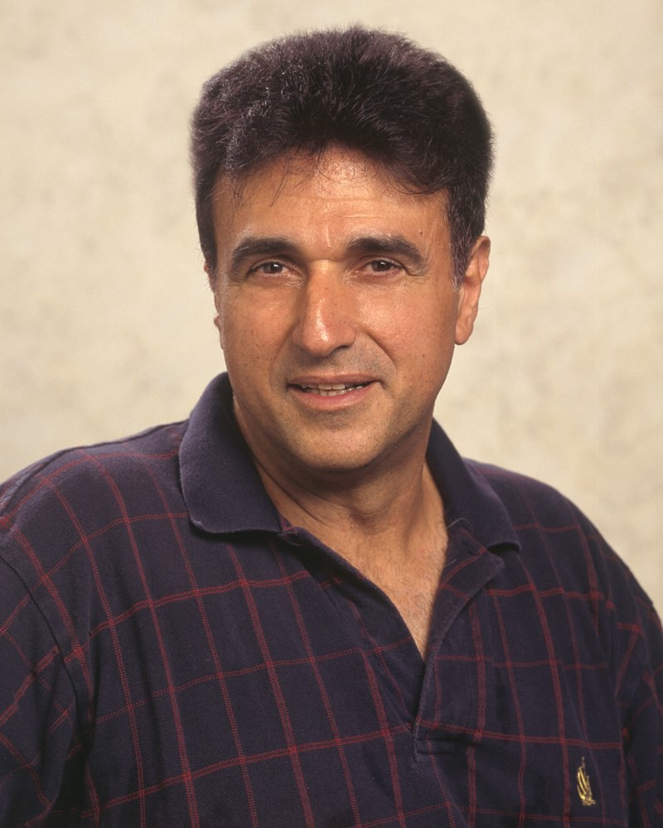
University Awards – Collis R. Geren Award for Excellence in Graduate Education
Greg Salamo
Faculty Award

Slide 31
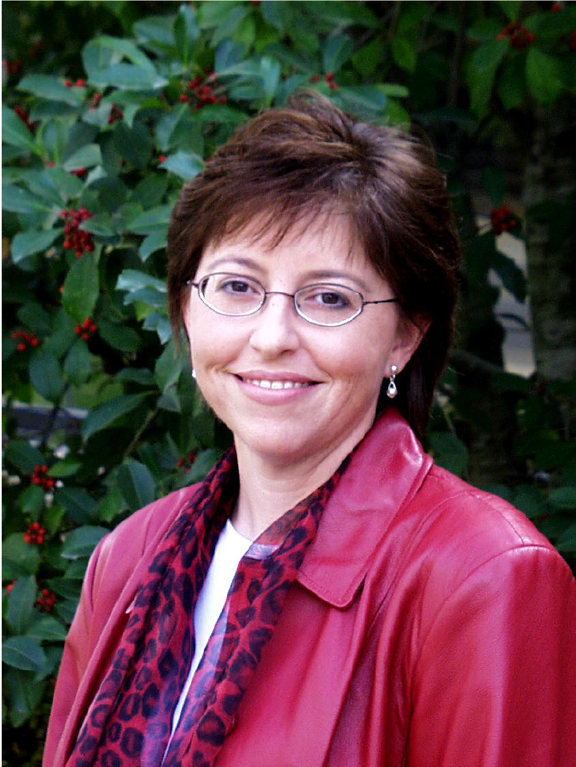
University Awards – Collis R. Geren Award for Excellence in Graduate Education
Renee Jones Hearon
GSIE Staff Award

Slide 32
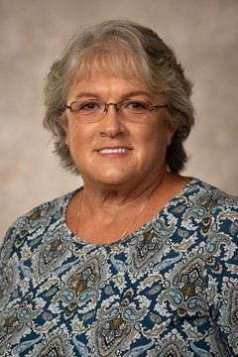
University Awards – Collis R. Geren Award for Excellence in Graduate Education
Brenda Foster
U of A Staff Award

Slide 33
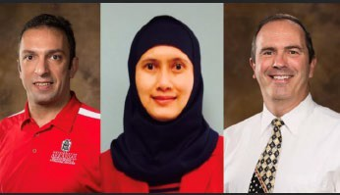
University Awards –
Hoyt Purvis Award for Service in International Education
Michael Freeman
Keukeu Abdullah
Adnan Alrubaye

Slide 34
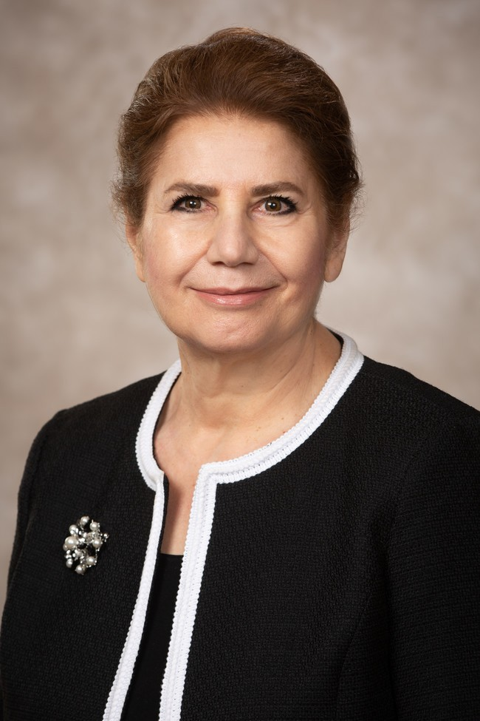
University Awards
Yassaman Mirdamadi was appointed to serve as a member of the Chancellor’s inaugural Diversity, Equity and Inclusion Council.
She was also recognized by the University as a “Portrait of Progress.”

Slide 35
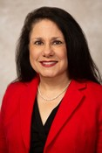
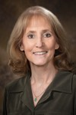
University Awards
DeDe Long and Kim Needy were recognized by the University as “Portraits of Progress.”

Slide 36
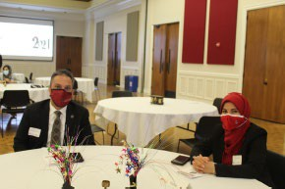
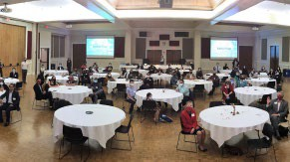
University Awards – Sponsored Students and Special Programs
Adnan Alrubaye, Ph.D.,was given the outstanding faculty award at an in-person banquet
Carlos Acosta, M.D. was named outstanding staff

Slide 37
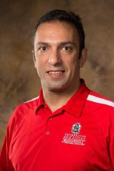
University Awards - Teaching Academy
Dr. Adnan Alrubaye (Cell and Molecular Biology; Poultry Sciences; Biological Sciences) was inducted into the Teaching Academy
He also received the 2019 Dr. John and Mrs. Lois Imhoff Award for Outstanding Teaching and Student Mentorship.

Slide 38
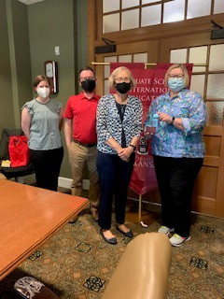
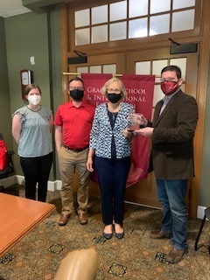
University Awards –
Gold Medals from the Office of Nationally Competitive Awards
Jim Gigantino - faculty
Vicky Hartwell - staff

Slide 39
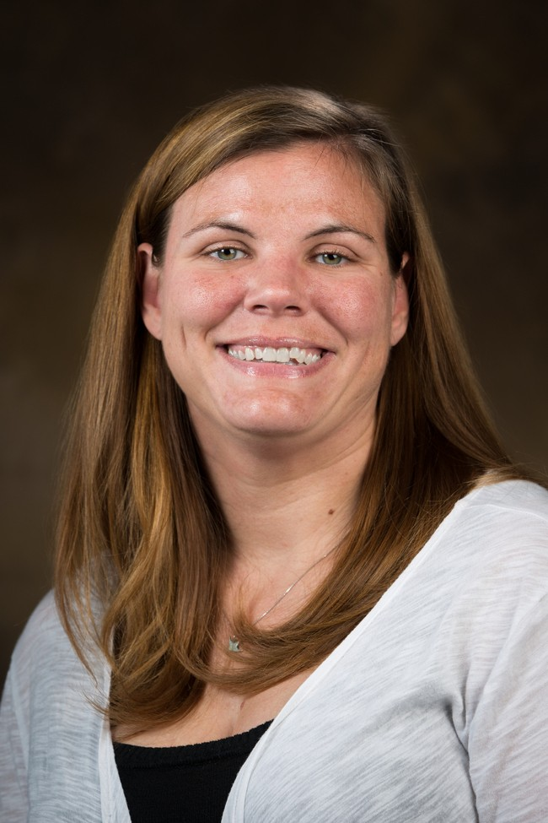
University Awards – Graduate Professional Student Congress
Laura Moix was named the Graduate Professional Student Congress Staff Ally of the Year.

Slide 40
University Awards – Bumpers College of Agricultural, Food and Life Sciences
Veronica Mobley was named Outstanding International Educator for the Bumpers College of Agricultural, Food and Life Sciences

Slide 41
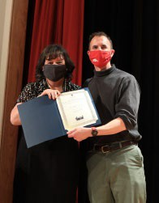
University Awards
At the ICT Banquet on April 24th, Vince Capps accepted the award on behalf of GSIE IT for going above and beyond in supporting the International Culture Team and International Education Week virtual events during COVID19.

Slide 42
Professional Awards
Kim Needy was immediate past president and member of the executive committee, Conference of Southern Graduate Schools
Yassaman Mirdamadi received the Lifetime Achievement for Testing in the Arkansas College Testing Association and the Advisor of the Month award from the Registered Student Association.
Francesco Bedeschi became a member of the steering committee of the Association of American College and University Programs in Italy.

Slide 43
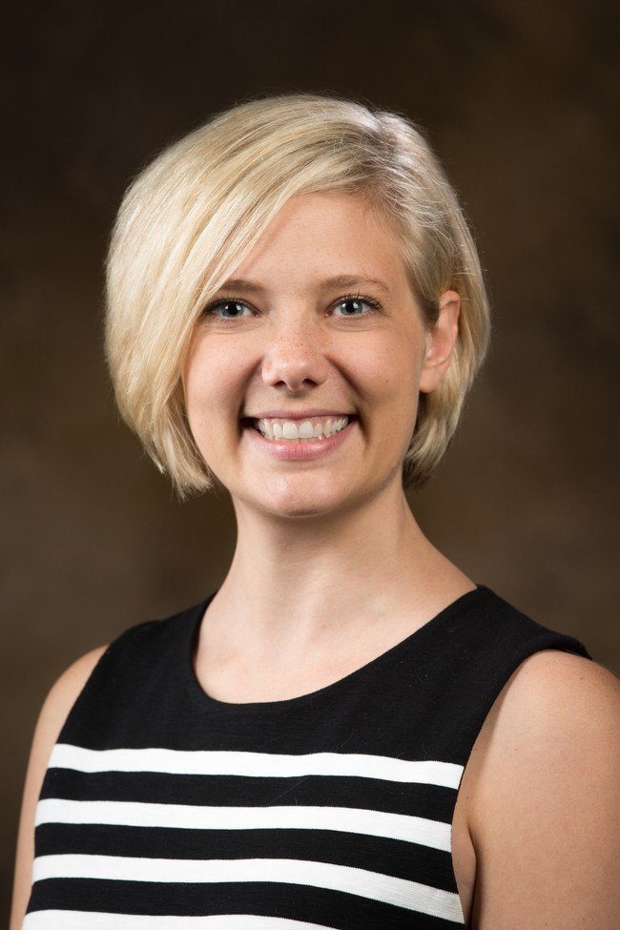
Professional Awards
Sarah Malloy was appointed to the ISA National Advisory Board.

Slide 44
Professional Awards
Cynthia Smith was named as the Arkansas State Outstanding International Educator, from NAFSA: Association of International Educators

Slide 45
Other Awards
Michael Rau was elected to the Staff Senate

Slide 46
Development
GSIE concluded a very successful year in fundraising and alumni engagement and outreach during 2020-21, despite the challenges presented by the COVID-19 pandemic. GSIE, in partnership with Research and Innovation, conducted a very successful Campaign Arkansas fundraising campaign which concluded in July 2020. Our unit far exceeded our campaign goal of $5 million, raising $3,437,207.19 for GSIE and
$208,081,274.52 for Research and Innovation.
In a time of critical need for our students, $8,743 was raised for the Needy Family Graduate Student Emergency Fund and $3,985 for the International Education Catastrophic Fund. $40,765 was awarded to students.

Slide 47
Graduate School and International Education
Instructional Technology: IT Services tirelessly supported staff in the transition to working remote and adjusting to new technologies. This has included the new phone systems moving to Teams, MFA implementation, Zoom and Teams conferencing, moving away from UITS document storage, new VPN, and implementing new system-wide security policies for the campus.
Finance: The GSIE Finance Office worked hard to support the transition from BASIS to Workday and spent many 16+hour days ensuring that GAs and GSIE staff were properly paid.
Communications: Amy Unruh, Director of GSIE Communications, continued to collaborate with other campus communicators in a University Relations “Student Communications” working group to help develop university-wide signage, email campaigns, welcome videos, and other messaging for students. A new monthly communication from the dean to all graduate students was initiated. The communications office also coordinated more than 35 media interviews with GSIE staff, providing important coverage of international student mobility, Study Abroad, graduate student stipends, social justice concerns, and COVID-19. Unruh also continued to participate on the university’s Communicable Disease Outbreak Committee and the Covid-19 Task Force (Communications subcommittee) to address university issues related to the pandemic.

Slide 48
Graduate School
Fall 2020 graduate enrollment was 4,354, a 4.4% increase from the year before and an all-time record. As a percentage of total University enrollment, graduate student enrollment in Fall 2020 was 15.8%, an increase from 15.1% the year before.
Graduate enrollment of under-represented minorities was 22.1% of total domestic graduate enrollment in Fall 2020 compared to 20.9% in Fall 2019.

Slide 49
Graduate School
In the most recent graduation year (2019-20), we awarded 1,120 master’s degrees (18 more than the year before) and 204 doctoral degrees (5 fewer than the previous year).
All of our student-facing offices offered virtual graduate student support and processing.

Slide 50
In AY 2020-21, there were 130 distinguished doctoral fellows and 243 Doctoral Academy Fellows.
There were seven SREB Doctoral Scholars.
Graduate School
There were 63 Benjamin Franklin Lever Fellows.
102 students received the new Chancellor’s Graduate Nonresident Tuition Scholarship.

Slide 51
Graduate School
The Graduate Admissions and Recruitment Office continued to develop new strategies to work towards engaging students in the remote environment. GIRAO implemented Live Chat, developed virtual 360-degree campus tours via Google Tours, and completed the RFP process for the StudentBridge, a digital video contract.

Slide 52
Graduate School
Laura Moix organized and directed our third annual Razorback Institute for Success and Engagement in August 2020 with virtual and face-to-face components for 15 participants. Three students from a past cohort served as peer mentors in the third year.

Slide 53
Graduate School: Graduate Student Virtual Support
New graduate student orientation
Writing Week
TA Teaching Camp
Research Days
Thursday Wellness Series
Career Success
Social Justice Series
Navigating Life as a Female Graduate Student
And the every popular “five things to know” Monday email.

Slide 54
Graduate School
We hosted a virtual scholars reception in March 2021 with 108 attendees.
Julie Rogers, with the Office of Graduate Student Support, presented virtual and in-person training programs about thesis and dissertation formatting.
The Graduate Admissions and Recruitment Office developed new strategies to engage students in a remote environment.

Slide 55
International Education
The academic year 2020-21 showed continued disruption of our international education landscape. International Students and Scholars met the challenges presented by COVID quarantines, social distancing, racial protests, implementation of Workday, loss of key staff members and remote work environments to provide outstanding programs and services to international students, the campus and the community. Visa office closures and COVID travel restrictions led to decreased number of international students and scholars at the University of Arkansas. Fall 2020 orientation was all virtual. The office monitored remote courses and out
-of-country enrollment for all F and J students. Workshops and sessions by advising staff as well as programs offered by the outreach and retention staff were all virtual. ISS also launched a new podcast series “International in NWA” to support students in the remote environment.

Slide 56
International Education
In Fall 2020, international students comprised 4.4% of the University’s on-schedule enrollment; international graduate students accounted for 16.4% of the total on-schedule graduate population.
The enrollment of international graduate students decreased over Fall 2019 by 45 students, from 745 in Fall 2019 to 700 in Fall 2020. The population of international undergraduate students decreased by 153 students, from 662 in Fall 2019 to 509 in Fall 2020.

Slide 57
International Education
The University of Arkansas was selected for IIE’s American Passport Project. U of A was one of 40 chosen among 200+ peer institutions to receive a grant in the amount of $3,625. The grant enables us to nominate 25 eligible students and give them each
$145 toward their U.S. passport application.
Specifically, these awards must go to Pell-eligible students thereby ameliorating an early barrier to study abroad. Additionally, several campus colleagues joined this effort to enhance and expand the Passport Project, including Enrollment Services/Office of Nationally Competitive Awards ($10,000), the eCAP program in Engineering ($5,000), and potentially more. Katie Sabo and Megan Hull were instrumental to this success.

Slide 58
International Education
A total of 49 students/scholars/spouses actively participated in the International Culture Team, presenting their culture in at least two events. An additional 21 students/scholars/spouses presented at least in one event totaling 108 presenters for the year. These students represented 35 different countries.
39 international students and scholars were matched to 33 Friendship Families and individuals from the NW Arkansas region in the Friendship Family Program. 17 international students were matched with 13 domestic students for a campus friendship in our Campus Cousin program.

Slide 59
International Education
We hosted a total of 83 sponsored students from Panama in the fall semester 2020; this was down from 99 in fall 2019. There were a total of 115 sponsored students from all organizations in fall 2020, down from 153 in Fall 2019.

Slide 60
International Education
Study Abroad transformed itself, transcending country borders virtually. Remote global learning experiences like virtual international internships and virtual “study abroad” programs emerged timidly in summer 2020 with five Honors students participating in a pilot program. But, by the following summer nearly as many students studied abroad in-person (109) as engaged in a virtual global learning experience (93).
Study Abroad won a competitive grant from the Forum for Education Abroad for complementary crisis management consulting, valued at nearly $6,000. This complementary consulting was offered to a limited number of Forum member institutions, based on demonstrated need and the urgency of current challenges. The consultancy lasted about 4-6 weeks beginning in early November through early January.
The study abroad participation of graduating seniors in FY20 was 16.4% versus 17.9% for FY19 and 16.7% in FY18.
Study Abroad registered a total of 1,557 applications (down 46% from last year). Only the Rome Center was able to run in-person programs, beginning in the summer 2021 term. Total enrollment in study abroad and global learning programs this year was 202, a decrease of 39% from last year. This represents a decrease in SSCH of 82% from pre-COVID numbers. However, there is much focus and energy in restarting study abroad opportunities in the coming academic year.

Slide 61
Rome Center
Rome Center core faculty taught remotely for the Fay Jones School in Fall 2020 and Spring 2021 while the Rome Center hosted no students.
Rome Center began face-to- face operations in Summer 2021 with 29 students and one faculty member from Fayetteville in residence in Rome.
A “Short Takes” video on the Rome Center reopening was featured on the university homepage for the month of April 2021. This generated new interest in Study Abroad as pandemic restrictions began to ease, allowing U of A students to study at the Rome Center after a year of remote-only experiences.

Slide 62
Interdisciplinary Programs
Cell and Molecular Biology, M.S., Ph.D.
Environmental Dynamics, Ph.D.
Materials Science
Engineering, M.S., Ph.D.
Public Policy, Ph.D.
Space and Planetary Sciences, M.S., Ph.D.
Statistics and Analytics, M.S.
CEMB: Doug Rhoads, Adnan Alrubaye
ENDY: Peter Ungar, JoAnn Kvamme
MSEN: Rick Wise, Renee Hearon
PUBP: Brinck Kerr, Valerie Hunt
SPAC: Larry Roe
STAN: Mark Arnold
Program Support:
Julie Brogan, Terri
Fisher and Emily Graham

Slide 63
Interdisciplinary Programs
Fall 2020 enrollment in interdisciplinary graduate programs was 2,556, a decrease of 12 students compared to Fall 2019
In the 2019-20 graduation year, the Graduate School awarded 32 interdisciplinary master’s degrees and 24 interdisciplinary doctoral degrees; accounting for 2.86% of the University’s master’s degrees and 11.76% of the University’s doctoral degrees.

Slide 64
Interdisciplinary Programs – Cell and Molecular Biology
The Ph.D. program in Cell and Molecular Biology was the second largest doctoral program on campus in Fall 2020 enrollments, with 79 students.
Cell and Molecular Biology students and faculty generated nearly $33.7 million in continuing grant support; $4.8 million in new grant support; prepared 54 peer- reviewed publications, and gave 63 invited lectures/presentations/ seminars.

Slide 65
Interdisciplinary Programs – Environmental Dynamics
Environmental Dynamics increased enrollment by 33% from 33 to 44 students. This includes the formal addition of the master’s program in Fall 2020 with three additional paths from a BS degree.
ENDY continued its partnership in the American Geophysical Union – Bridge Program (one of only 14 universities in the U.S.) which has the goal of advancing the representation of underserved populations in earth sciences.
Three students in Environmental Dynamics received Sturgis fellowships for 2020-21.
During the 2020-21 year, Environmental Dynamics students were awarded over
$295,000 in funding from sources external to the University.

Slide 66
Interdisciplinary Programs – Materials Science Engineering
The Microelectronics–photonics program was reconfigured and renamed (beginning fall 2020) to Materials Science and Engineering. The program now offers two MS degrees (Materials Science and Materials Engineering) and one PhD Degree in Materials Science and Engineering.
MSEN students authored/co-authored 59 papers/presentations and had five provisional patents and one non-provisional patent filed in the 2020-21 academic year.
The MSEN program concluded its seven-year review with accolades from external evaluators.

Slide 67
Interdisciplinary Programs – Public Policy
The Public Policy program began a new Social Justice specialization with Dr. Anna Zajicek as the specialization coordinator. Nine faculty members joined the Public Policy Program during the academic year.
Professor Geoboo Song of the Public Policy program continues to serve as Associate Editor of Policy Studies Journal, a high impact publication. The presence of the journal significantly increases the visibility and reputation of PUBP. Policy Studies Journal has a two-year JIF of 5.141, and ranked 17/182 in Political Science and 7/41 in Public Administration. The JCI indicates that PSJ got a
2.79 (179% more citation impact than the
average journal in the requisite category). According to the JCI, PSJ ranked 10/293 in Political Science and 3/78 in Public Administration.
In 2020-21, students in Public Policy published or had accepted for publication 15 peer- reviewed journals and presented 14 conference papers. Faculty published or had accepted for publication 63 peer-reviewed journal articles, three books, and were PI or Co-PI on over $4 million in grant funding.

Slide 68
Interdisciplinary Programs – Space and Planetary Sciences
Space and Planetary Sciences student Jill McDonald was selected for a 2021 NASA Future Investigators in NASA Earth and Space Science and Technology (FINESST) fellowship; one of only 32 awarded nationwide. Current PhD student Katherine Dzurilla was elected as President of the Graduate-Professional Student Congress, replacing another interdisciplinary (PUBP) PhD student, JD DiLoretto-Hill.
Space and Planetary Sciences faculty submitted 14 research proposals; faculty and students had 14 journal articles published and 23 conference papers/posters accepted for presentation.

Slide 69
Interdisciplinary Programs – Statistics and Analytics
72 faculty from 20 departments participated in the Statistics and Analytics (STAN) program.
17 students graduated from STAN in 2020-21.

Slide 70
Thank you for all you do –
it’s a lot!

